Slide 1
Power BI Dashboard
Job Attrition

Slide 2
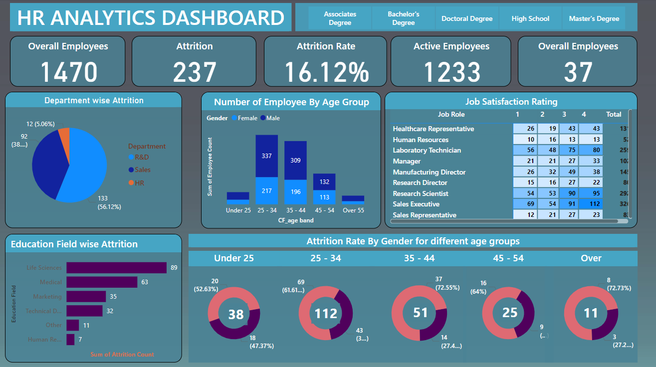
Complete Dashboard

Slide 3
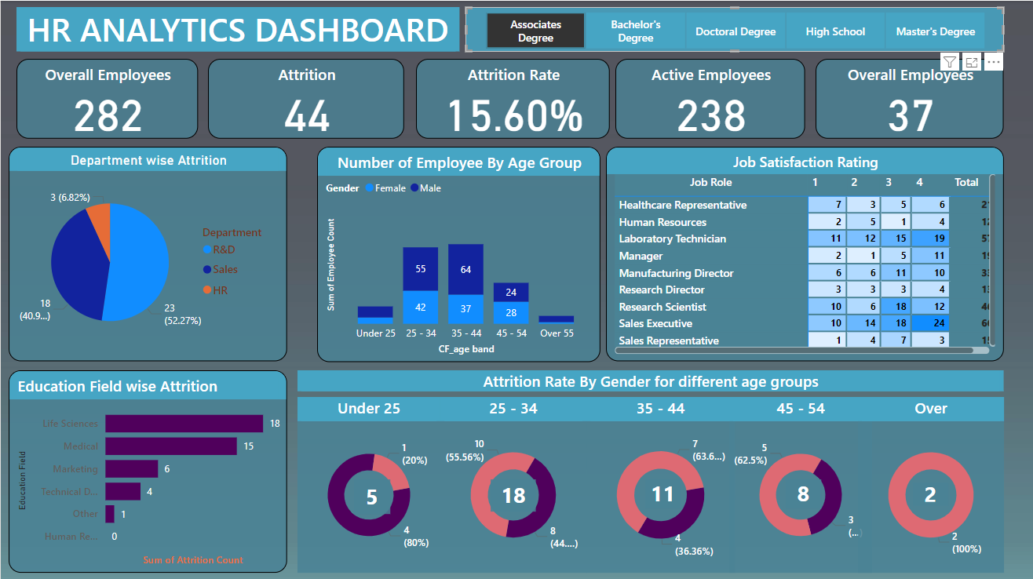
According to Associates Degree selection

Slide 4
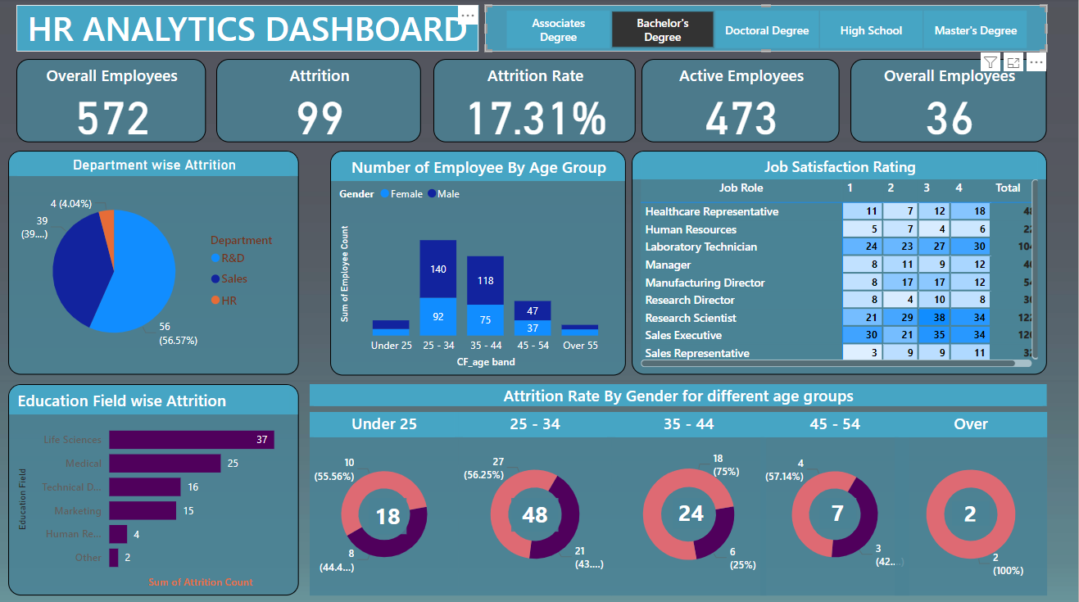
According to Bachelor’s Degree

Slide 5
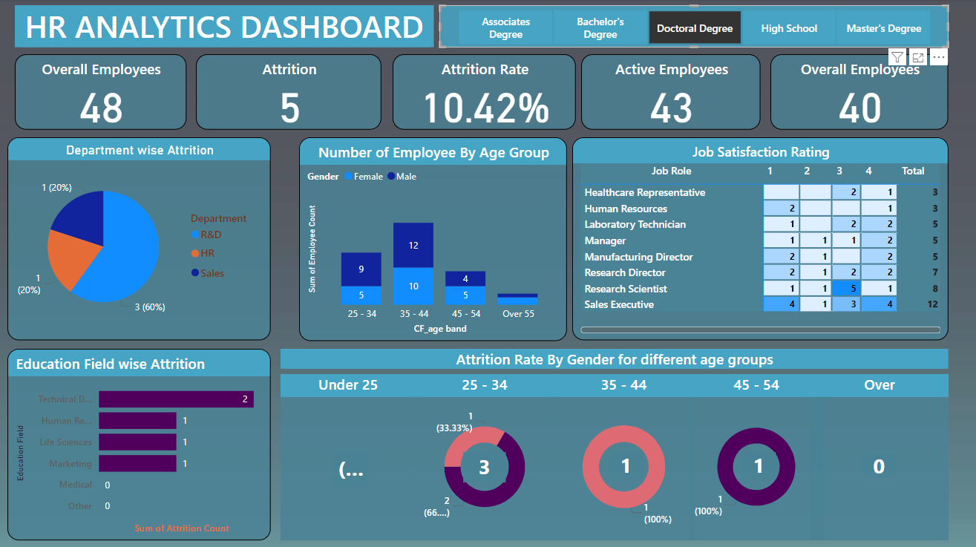
According to Doctoral Degree

Slide 6
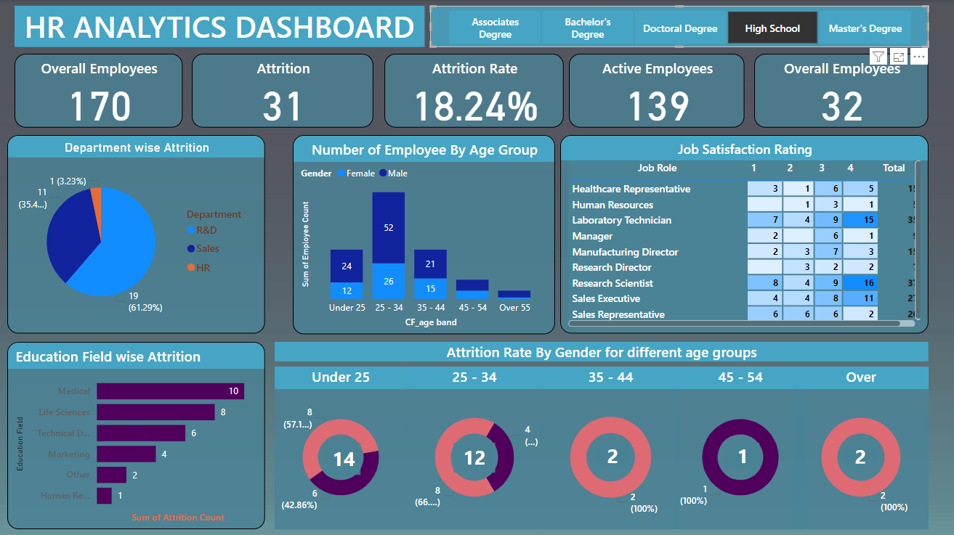
According to High School selection

Slide 7
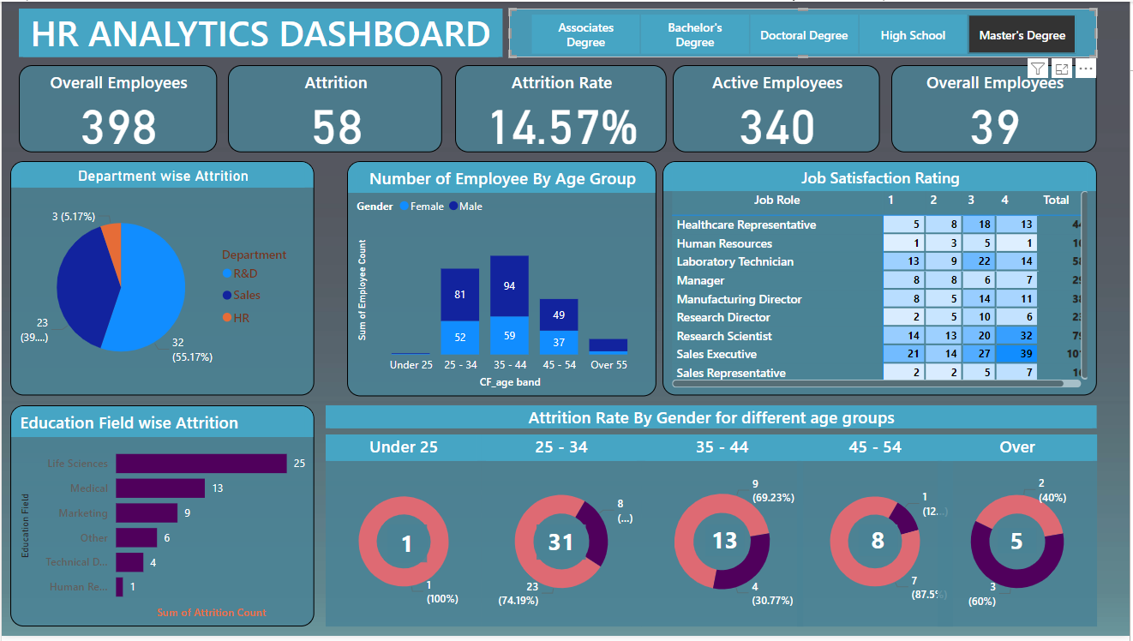
According to Master’s program

Slide 8
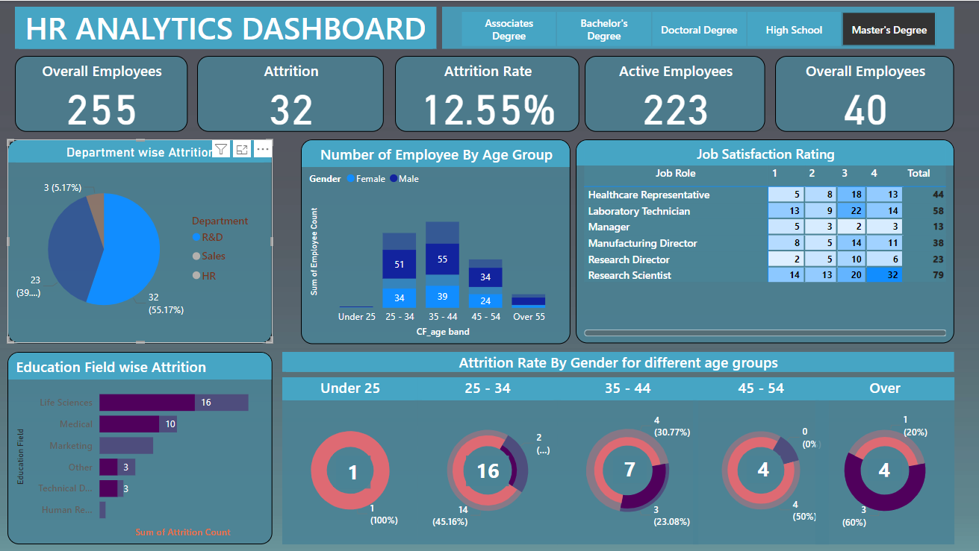
According to select Research and Development Department

